Slide 1
Your Organization
Poster instructions
Title goes here
Program Description
Detailed description of the program, goals, and audience. (Font size 32 pt or greater).
Only black text with a white background.
Graphics/Images (if applicable)
This panel should contain visual representations of your main findings and image description text (Font size 28pt or greater). All graphics go on this panel.
This panel can also be used for additional text if you do not have any graphics.
You may change the background color, but please keep it a dark shade for maximum contrast. All text must be white.
This panel should have a light background. preferably a lighter shade of the middle panel, with black text.
Your photo or graphic goes here
Replace the QR code with your own if you choose to use one.
Free QR code generators are available online.
YOUR LOGO
HERE
SCAN HERE FOR MORE INFORMATION
YOUR CONTACT INFO
First Name Last Name
userID@cdc.gov
Your website goes here

Slide 2
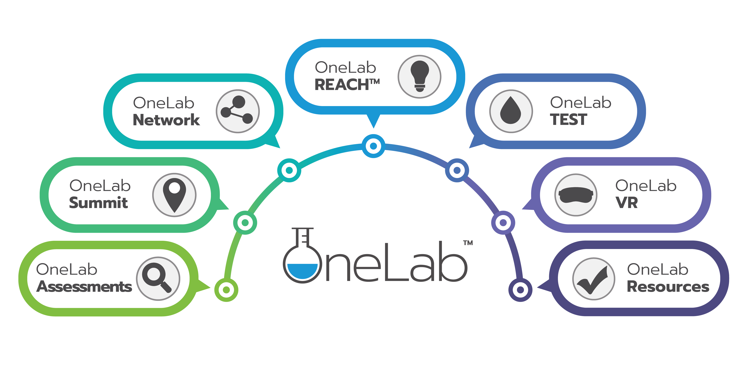
Sample poster
Centers for Disease Control and Prevention
Program Description (sample)
The Centers for Disease Control and Prevention’s OneLabTM initiative is designed to strengthen interconnections between clinical and public health laboratories to collectively support rapid, large-scale public health responses through education and training.
This initiative serves the broader needs of the laboratory and testing community to better deliver laboratory and testing education and training resources to its audiences.
The OneLab Network is poised to serve as an ongoing learning community, connecting professionals with a role in the training and continuing education of the clinical and public health laboratories and the non-traditional testing community.
OneLab Network
OneLab REACH
OneLab TEST
OneLab VR
YOUR LOGO
HERE
SCAN HERE FOR MORE INFORMATION
YOUR CONTACT INFO
First Name Last Name
OneLab@cdc.gov
OneLab

